Slide 1

HOTEL RESERVATION MANAGEMENT SYSTEM
K. Sai Tejaswi : 25B11CS336
C. Keerthana : 25B11CS158
A. Namratha : 25B11CS052
Venkata Kiran Teja: 26B21CS160

Slide 2
Real-World Problem
Hotels need to manage many customers, rooms, reservations, check-ins,
check-outs, and payments. Managing all these details manually can lead to
errors, duplicate bookings, and difficulty in finding information. It can also
take more time to check room availability and customer records. Our Hotel
Reservation Management System solves these problems by storing and
managing hotel information in a database.

Slide 3
Why the Project is Needed
The project is needed to make hotel reservation activities faster, easier, and
more organized. It helps staff quickly check available rooms and manage
customer bookings. It reduces manual paperwork and avoids common
errors such as double booking. The system also makes it easier to store,
update, and retrieve customer, room, reservation, and payment details.

Slide 4
Objectives of the project
To maintain customer details in a database.
To manage room details and room availability.
To allow customers to make and cancel reservations.
To maintain check-in and check-out details.
To store and manage payment information.
To reduce manual work and data entry errors.
To provide quick and accurate access to hotel records.

Slide 5
Functional Requirements
Functional Requirements are the tasks the system should perform:
Register and manage customer details.
Add, update, and delete room information.
Check room availability.
Create and cancel reservations.
Manage check-in and check-out.
Record payment details.
Generate reservation and customer records.

Slide 6
Non-Functional Requirements
Non-Functional Requirements describe how the system should work:
Security: Customer and payment information should be protected.
Reliability: The system should provide accurate information.
Performance: The system should respond quickly to user requests.
Usability: The system should be simple and easy to use.
Scalability: The database should support more customers, rooms, and reservations as the hotel grows.
Data Integrity: The database should maintain correct and consistent records.

Slide 7
End Users of the System
Hotel Receptionists:
Manage guest details, room reservations, check-ins, check-outs, and payment records.
Hotel Managers:
View and manage hotel, room, staff, reservation, and payment information.
Guests:
Check room availability, provide personal details, and make or cancel reservations.
Hotel Staff:
Manage room status, assist guests, and update reservation-related information.
Administrators:
Manage the database, system users, hotel information, and overall system operations.

Slide 8
Entities and Attributes
Hotel
Stores information about hotels in the system.
Attributes:
1.Hotel_ID — Primary Key
2.Hotel_Name
3.Location
4.Contact_No
Why included?
We need hotel details to identify each hotel and store its basic information such as name, location, and contact number.

Slide 9
Room
Stores information about the rooms available in the hotel.
Attributes:
1. Room_ID — Primary Key
2. Room_Type
3. Price
Why included?
The hotel needs to know which rooms exist, their types, prices, and whether they are available or occupied.

Slide 10
Guest
Stores information about people who book rooms.
Attributes:
Guest_ID — Primary Key
Guest_Name
Phone
Email
Why included?
We need guest details to identify who made each reservation and to maintain their contact information.

Slide 11
Staff
Stores information about staff members working in the hotel.
Attributes:
Staff_ID — Primary Key
Staff_Name
PhoneNo
Role
Why included?
We need staff details to identify hotel employees and maintain information about their contact details and roles.

Slide 12
Reservation
Stores information about room reservations made by guests.
Attributes:
Reservation_ID — Primary Key
Check_In
Check_Out
Status
Why included?
We need reservation details to track bookings, check-in and check-out dates, and the current status of each reservation.

Slide 13
Payment
Stores information about payments made for reservations.
Attributes:
Payment_ID — Primary Key
Amount
Payment_Date
Payment_Status
Why included?
We need payment details to record the amount paid, payment date, and payment status for each reservation.

Slide 14
Relationships
Hotel — Room
Relationship: Contains
Cardinality: 1:M
One hotel can contain many rooms, but each room belongs to one hotel.
Example:
Hotel can contain Room 1, Room 2, Room 3, etc.

Slide 15
Hotel — Staff
Relationship: Employs
Cardinality: 1:M
One hotel can employ many staff members, but each staff member works for one hotel.
Example:
Hotel can employ Staff 1, Staff 2, Staff 3, etc.

Slide 16
Guest — Reservation
Relationship: Makes
Cardinality: 1:M
One guest can make many reservations, but each reservation is made by one guest.
Example:
Guest 101 can make Reservation 1, Reservation 2, etc.

Slide 17
Room — Reservation
Relationship: Reserved_through
Cardinality: 1:M
One room can be associated with many reservations over time, but each reservation is for one room.
Example:
Room 101 can have Reservation 1, Reservation 2, etc.

Slide 18
Reservation — Payment
Relationship: Has
Cardinality: 1:1
One reservation has one payment, and each payment belongs to one reservation.
Example:
Reservation 1 has Payment 1.

Slide 19
Relational Schema
HOTEL(
Hotel_ID:INT PK, Hotel_Name:VARCHAR
(50),
Location:VARCHAR(100), Contact_No:VARCHAR
(15))
ROOM(
Room_ID:INT PK, Room_Type:VARCHAR
(30),
Price:REAL,
Hotel_ID:INT FK
)
STAFF(
Staff_ID INT PK, Staff_Name:VARCHAR
(50),
Role:VARCHAR(30), Phoneno:VARCHAR
(15),
Hotel_ID:INT FK)
GUEST(
Guest_ID:INT PK, Guest_Name:VARCHAR
(50),
Phone:VARCHAR(15), Email;VARCHAR(100)
)
RESERVATION(
Reservation_ID:INT PK, Check_In:DATE, Check_Out:DATE, Status:VARCHAR(20), Guest_ID:INT FK, Room_ID:INT FK
)
PAYMENT(
Payment_ID:INT PK, Amount:REAL, Payment_Date:DATE, Payment_Status:
VARCHAR(20), Reservation_ID:INT FK
)

Slide 20
Cardinality
Hotel–Room: 1:M
One hotel can contain many rooms, but each room belongs to one hotel.
Hotel–Staff: 1:M
One hotel can employ many staff members, but each staff member works for one hotel.
Guest–Reservation: 1:M
One guest can make many reservations, but each reservation belongs to one guest.
Room–Reservation: 1:M
One room can have many reservations over different periods, but each reservation is for one room.

Slide 21
Reservation–Payment: 1:1
One reservation has one payment record, and one payment record belongs to one reservation in our basic system.
M:N relationship:
Guest and Room can have an M:N relationship because one guest can book different rooms and one room can be booked by different guests over time. This M:N relationship is handled through the Reservation entity.

Slide 22
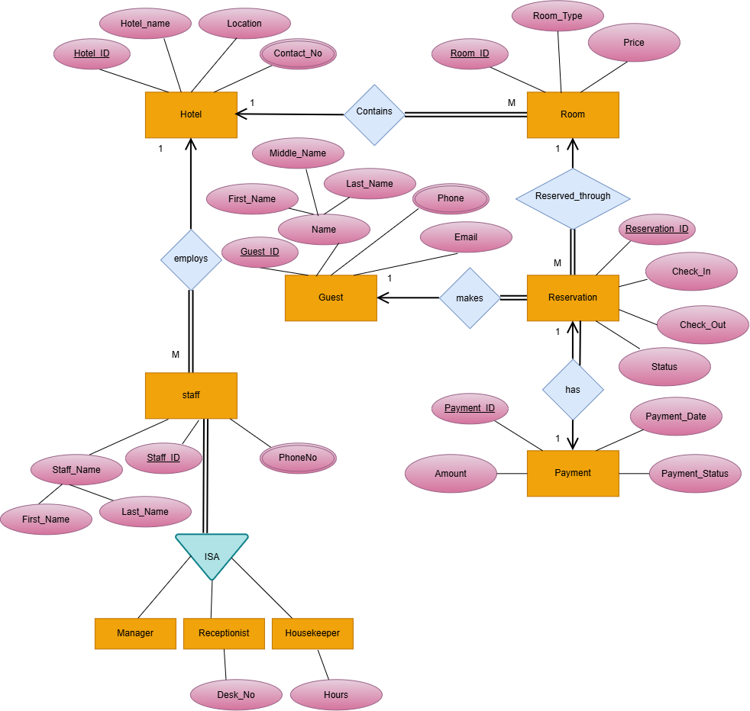
ER Diagram

Slide 23
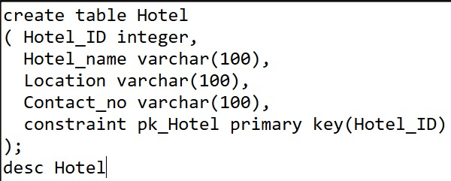
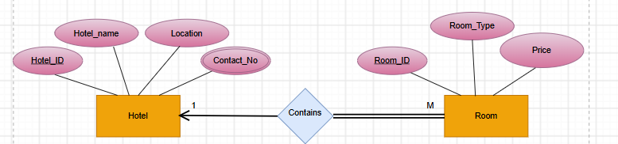
Entity sets to Tables
Hotel Table

Slide 24
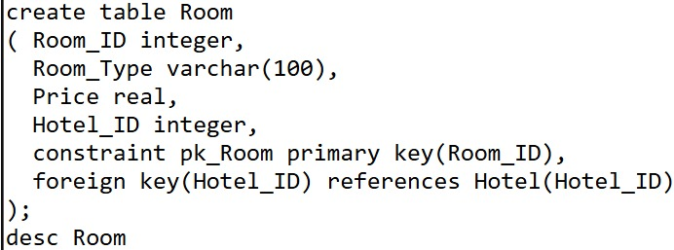
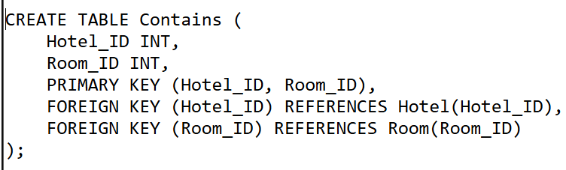
Room Table

Slide 25
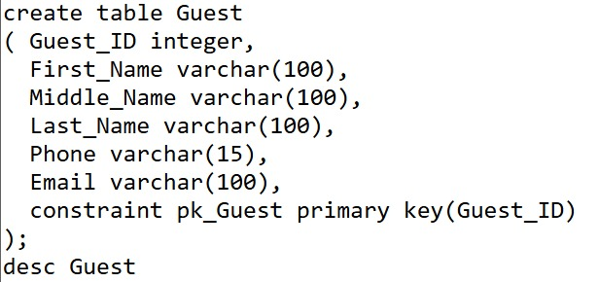
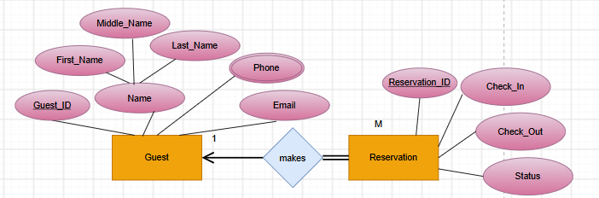
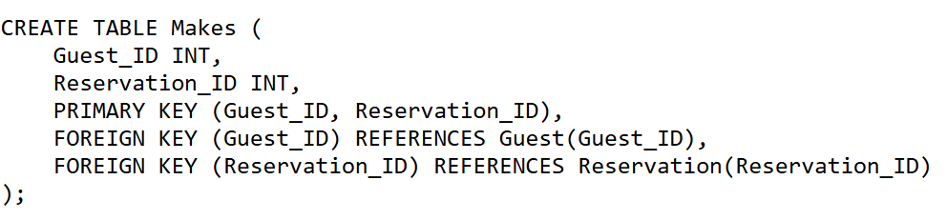
Guest Table

Slide 26
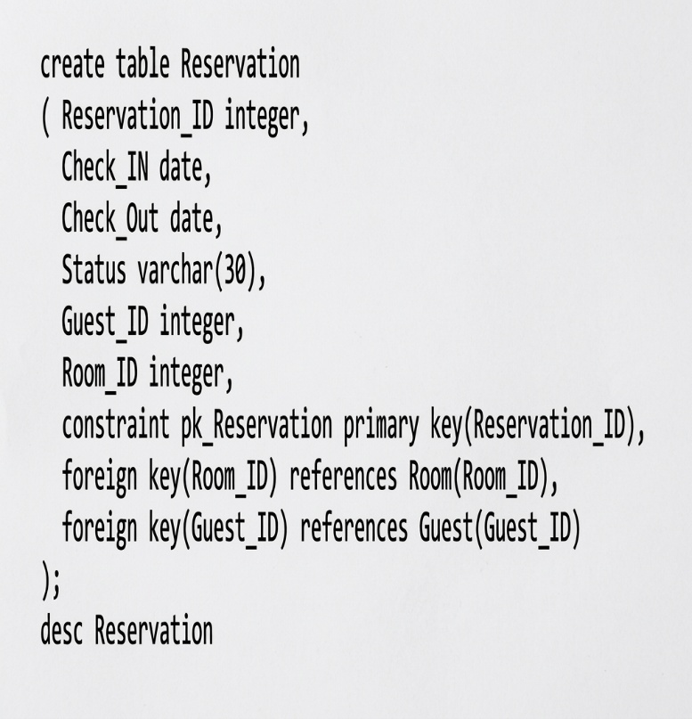
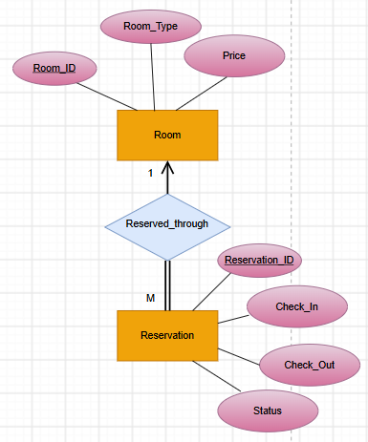
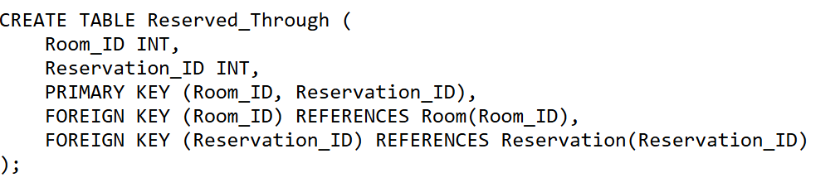
Reservation Table

Slide 27
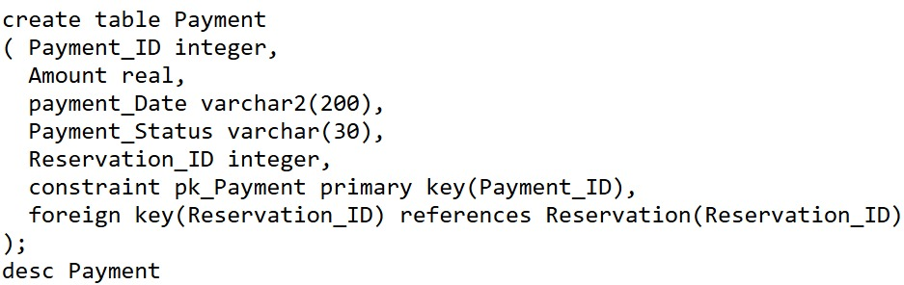
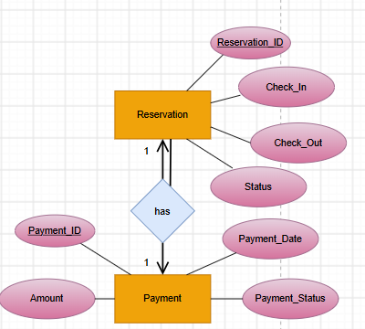
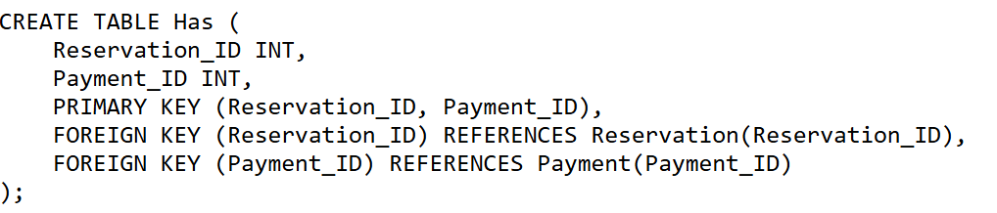
Payment Table

Slide 28
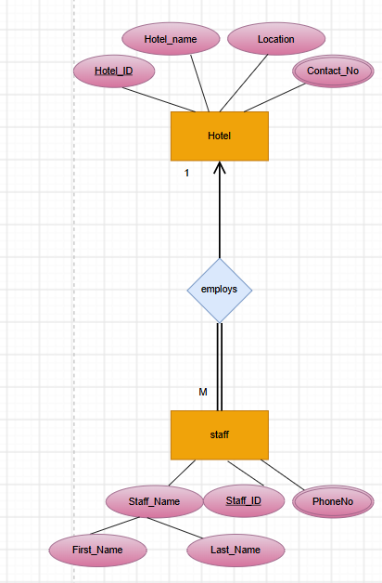
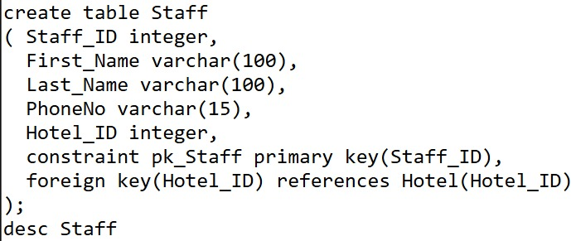
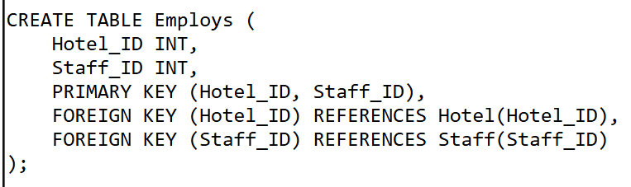
Staff Table

Slide 29
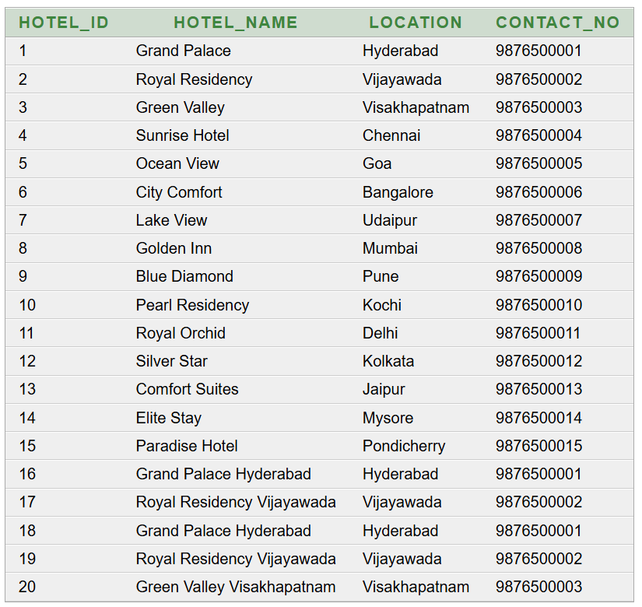
Hotel Table

Slide 30
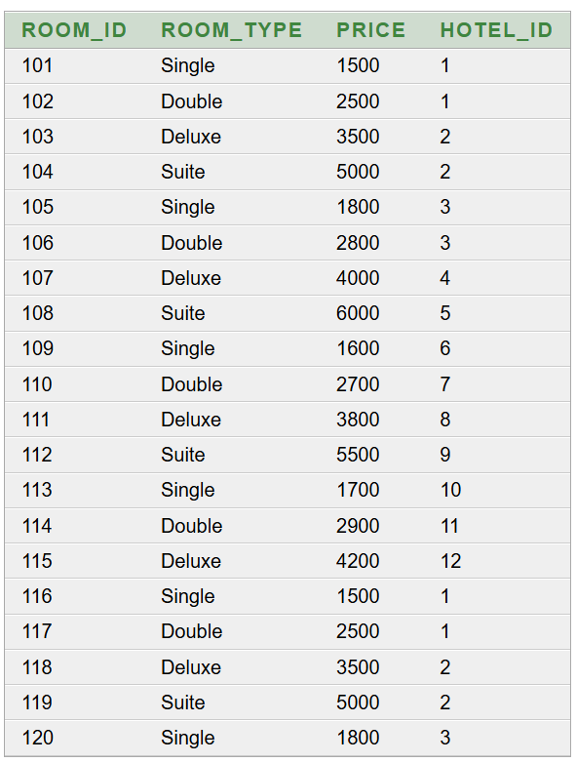
Room Table

Slide 31
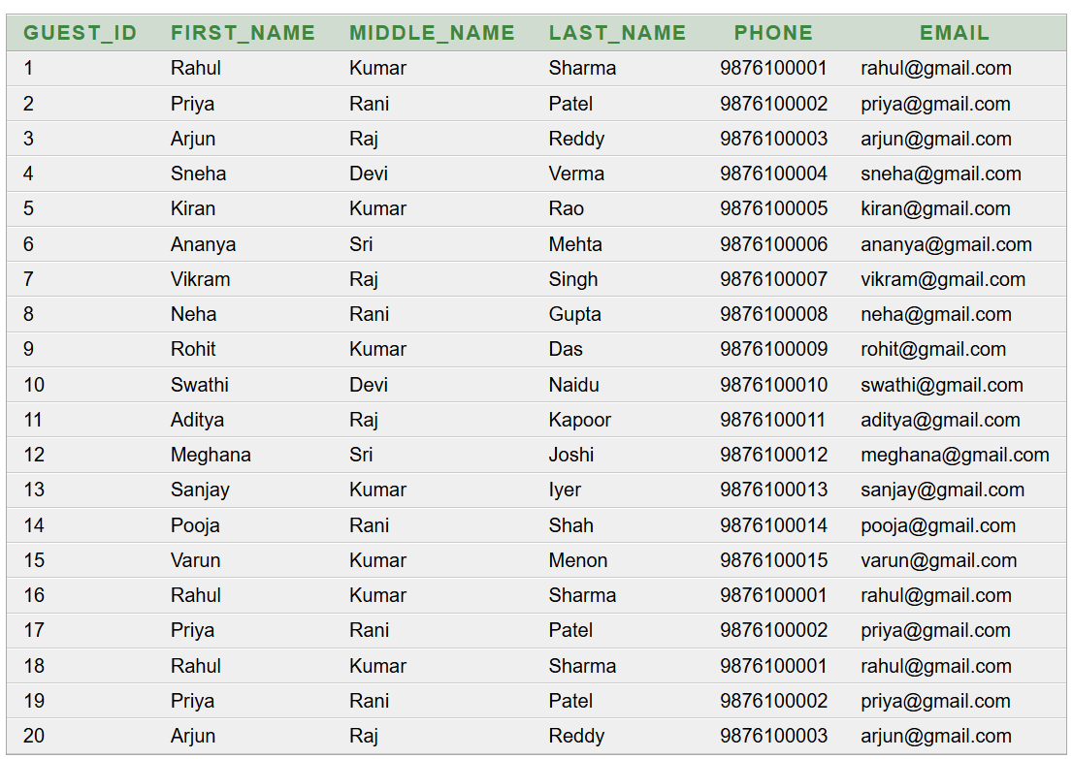
Guest Table

Slide 32
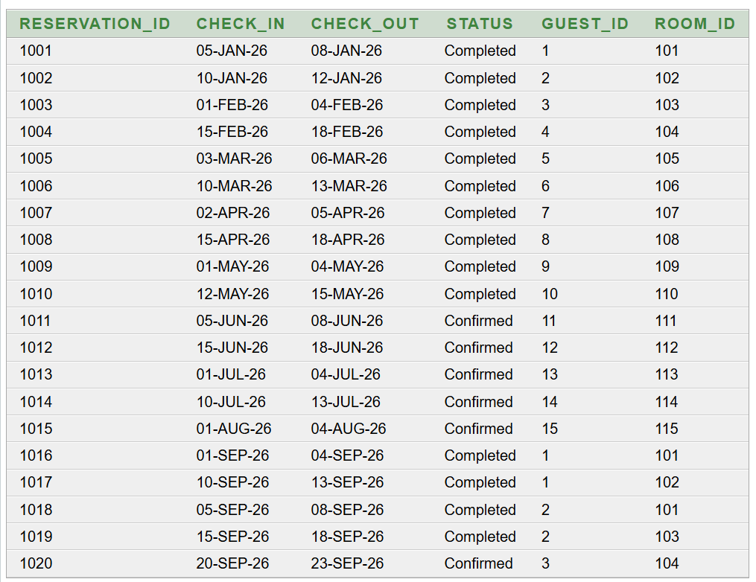
RESERVATION TABLE

Slide 33
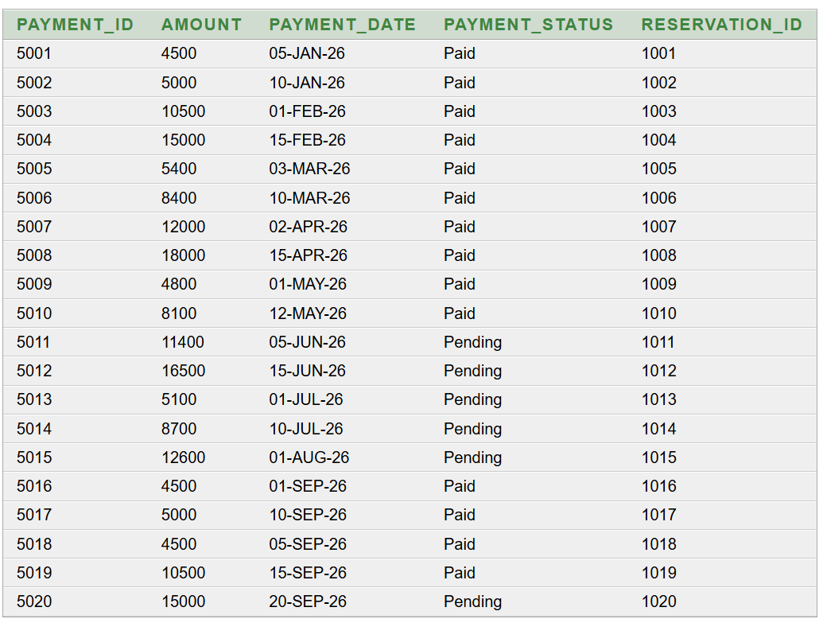
PAYMENT TABLE

Slide 34
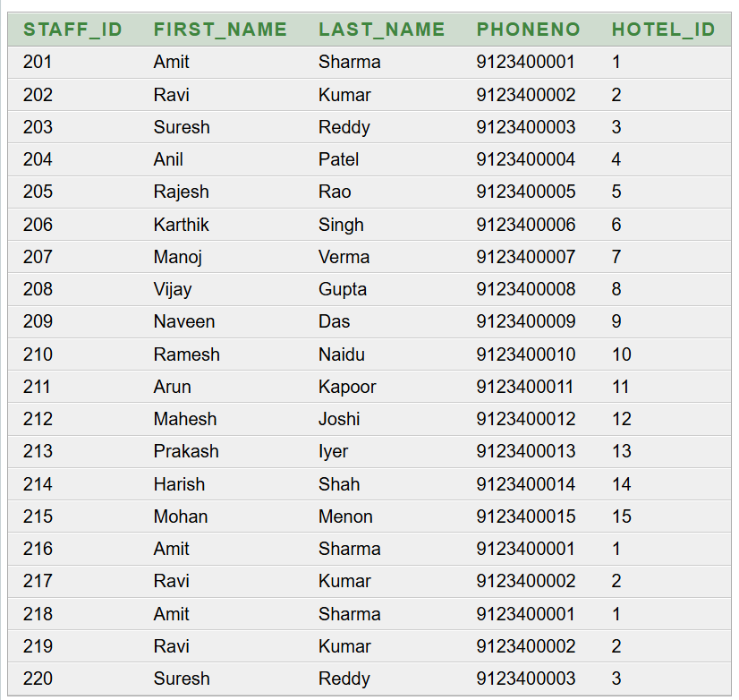
STAFF TABLE

Slide 35
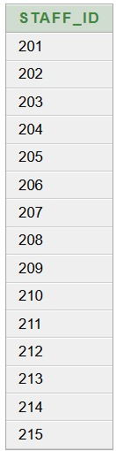
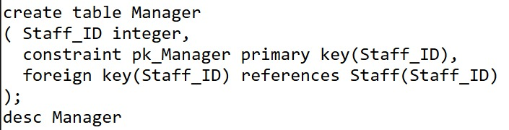
Manager Table

Slide 36
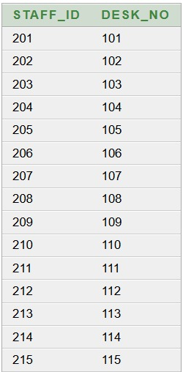
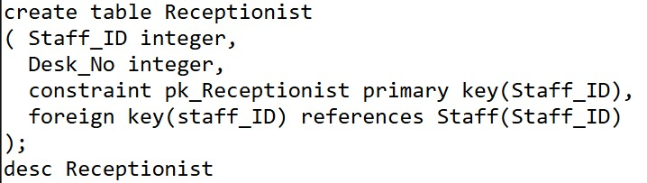
Receptionist Table

Slide 37
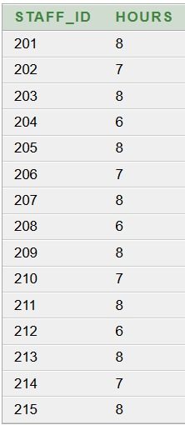
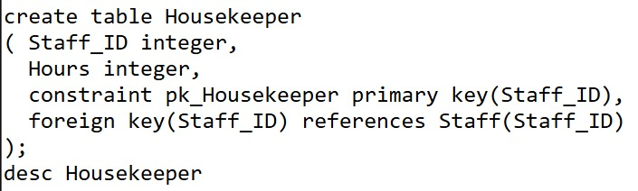
Housekeeper Table

Slide 38
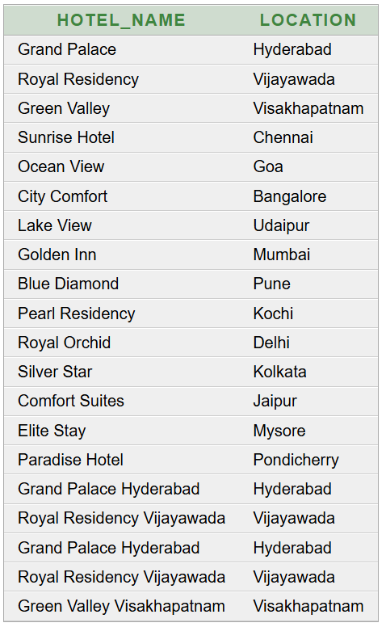
QUERIES
Basic Queries
Query 1: Retrieve all hotels and their locations
SQL>SELECT Hotel_name, Location FROM Hotel;

Slide 39
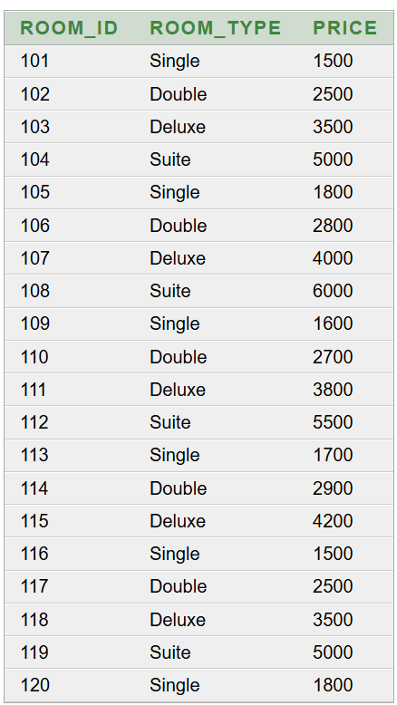
Query 2:List all rooms along with their prices
SQL>SELECT Room_ID, Room_Type, Price FROM Room;

Slide 40
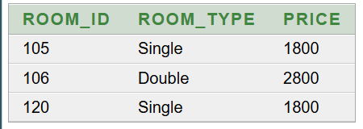
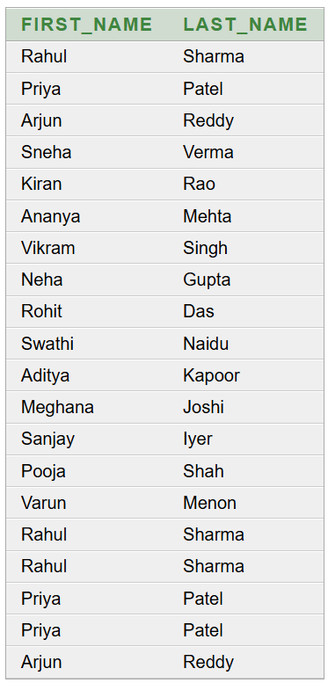
Query 3:Find all rooms in a specific hotel
SQL>select r.Room_ID, r.Room_Type,r.Price from Room rwhere r.Hotel_ID IN (select h.Hotel_ID from Hotel h where h.Hotel_name = 'Green Valley')
Query 4: Find all guests who have made a reservation
SQL>select g.First_Name, g.Last_Name from Guest g,Reservation rwhere g.Guest_ID = r.Guest_ID

Slide 41
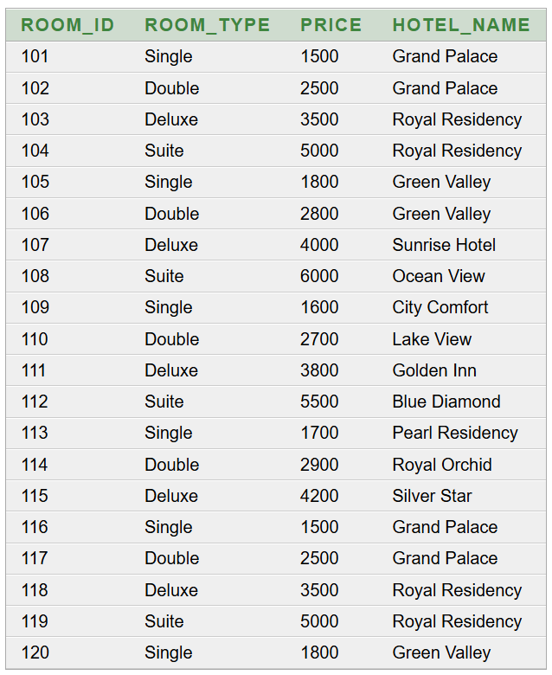
Query 5: List rooms along with their hotel names
SQL>select r.Room_ID,r.Room_Type,r.Price,h.Hotel_name from Room r,Hotel hwhere r.Hotel_ID = h.Hotel_ID

Slide 42

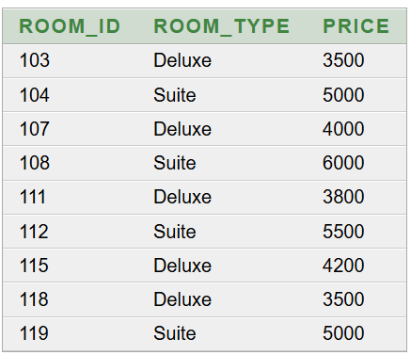
Query 6:Find staff members working in a specific hotel
SQL>SELECT s.Staff_ID,s.First_Name,s.Last_Name,s.PhoneNo FROM Staff sWHERE s.Hotel_ID = 5;
Query 7: Show rooms that cost more than 3000
SQL>select Room_ID, Room_Type,Price from Roomwhere Price > 3000

Slide 43
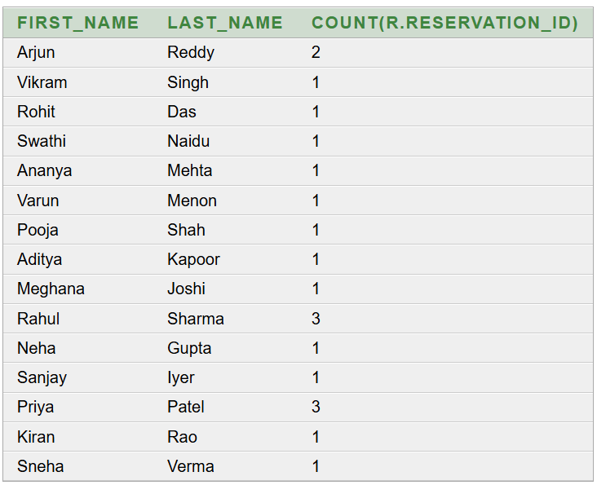
ADVANCED QUERIES
Query 1: Count the number of reservations made by each guest
SQL>select g.First_Name,g.Last_Name,count(r.reservation_ID) from Guest g,Reservation rwhere g.Guest_ID = r.Guest_ID Group by g.First_Name , g.Last_Name

Slide 44

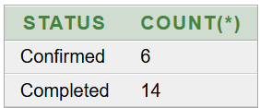
Query 2: Find the most expensive room
SQL>select Room_ID, Room_Type,Price from Roomwhere Price = (select max(Price) from Room)
Query 3: Count reservations according to their status
SQL>select Status, count(*) from ReservationGroup by Status

Slide 45

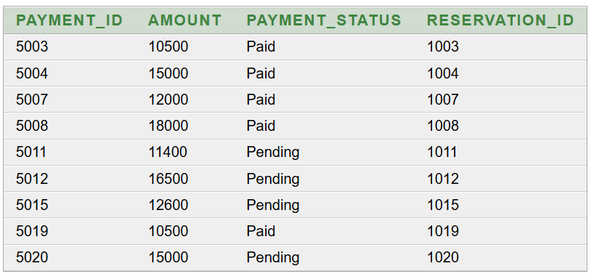
Query 4:Find the average room price
SQL>select avg(Price) from Room
Query 5: Find payments greater than ₹10,000
SQL>select Payment_ID, Amount,Payment_Status,Reservation_ID from Payment where Amount > 10000

Slide 46
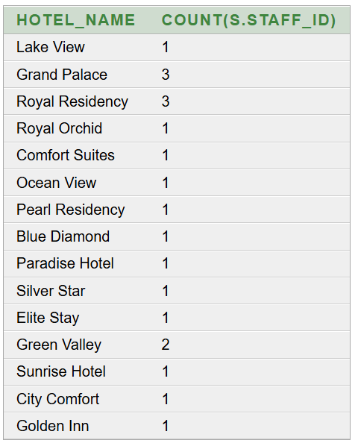
Query 6: Count the number of staff working in each hotel
SQL>select h.Hotel_name, count(s.Staff_ID) from Hotel h,Staff swhere h.Hotel_ID = s.Hotel_ID Group by h.Hotel_name

Slide 47


Query 7: Find the total amount of all payments
SQL>select sum(Amount) from Payment
Query 8: Find the total payment received from completed reservations
SQL>select sum(p.Amount) from Payment pwhere p.Reservation_ID IN (select r.Reservation_ID fromReservation r where r.Status = 'Completed' AND p.Payment_Status = 'Paid')

Slide 48
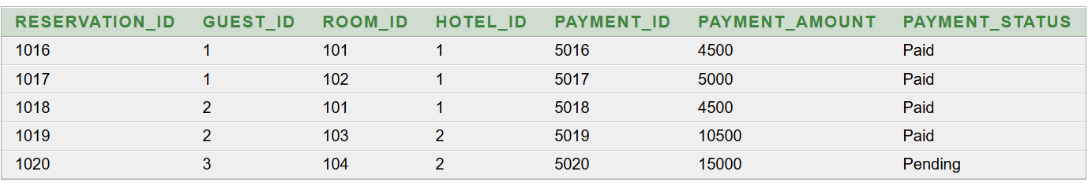
FIRST NORMAL FORM
Functional Dependencies
RESERVATION_ID → GUEST_ID, ROOM_ID, HOTEL_ID, PAYMENT_ID
PAYMENT_ID → PAYMENT_AMOUNT, PAYMENT_STATUS
ROOM_ID → HOTEL_ID (each room belongs to exactly one hotel)
Transitive: RESERVATION_ID → ROOM_ID → HOTEL_ID
Candidate keys: RESERVATION_ID (primary key). PAYMENT_ID is also a candidate key, since each reservation has one payment.

Slide 49
1NF:
All attribute values are atomic (no multi-valued or composite columns).
There are no repeating groups.
A primary key (RESERVATION_ID) uniquely identifies each row.
Conclusion: the table is in 1NF.
It is also in 2NF, because the key is a single attribute, so no partial dependency is possible.
It is not in 3NF, because of the non-key dependency ROOM_ID → HOTEL_ID.
Redundancy / Anomalies in 1NF :
The pair (ROOM_ID 101, HOTEL_ID 1) is stored twice, in reservations 1016 and 1018.
HOTEL_ID repeats for every reservation of the same hotel.
Update anomaly: if Room 101 moves to another hotel, every row must be changed.
Insertion anomaly: a new room cannot be recorded until someone reserves it.
Deletion anomaly: deleting the only reservation for a room also deletes the fact that the room belongs to that hotel.

Slide 50
Lossless Join:
RESERVATION ∩ ROOM = {ROOM_ID}, which is the key of ROOM, so the split is lossless.
RESERVATION ∩ PAYMENT = {PAYMENT_ID}, which is the key of PAYMENT, so the split is lossless.
Joining the three tables reproduces the original table with no missing or spurious tuples.
All FDs are preserved, so the decomposition is also dependency-preserving.
.

Slide 51
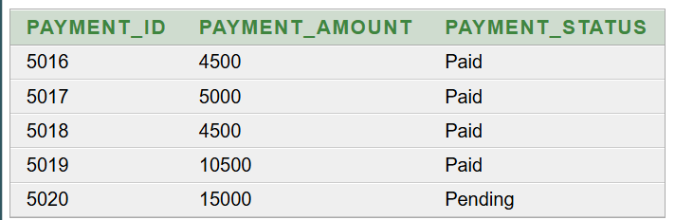
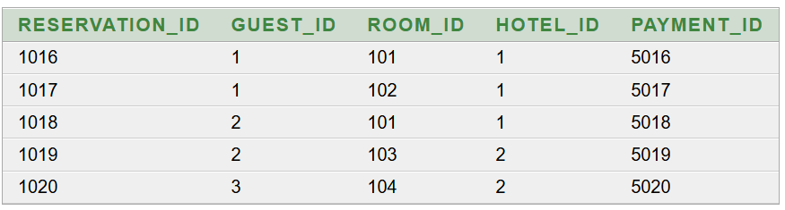
SECOND NORMAL FORM
Functional Dependencies
PAYMENT_ID → PAYMENT_AMOUNT, PAYMENT_STATUS
RESERVATION_ID → GUEST_ID, ROOM_ID, HOTEL_ID, PAYMENT_ID
ROOM_ID → HOTEL_ID

Slide 52
2NF:
Rule: A table is in 2NF if it is in 1NF and has no partial dependency (no non-key attribute depends on only part of the primary key).
Both keys are single attributes, so partial dependency is not possible.
Conclusion: both tables are in 2NF.
Redundancy / Anomalies in 2NF
Removed by this split:
Payment details (amount and status) are stored only in PAYMENT, once per PAYMENT_ID.
A payment change (for example Pending → Paid) is made in one place, so there is no update anomaly.
Payment data no longer mixes with reservation data.

Slide 53
Lossless Join:
PAYMENT ∩ RESERVATION = {PAYMENT_ID}
PAYMENT_ID is the primary key of PAYMENT, so the decomposition is lossless.
Joining the two tables on PAYMENT_ID reproduces the original 5 rows with no missing or extra tuples.
All FDs are preserved, so the decomposition is also dependency-preserving.

Slide 54
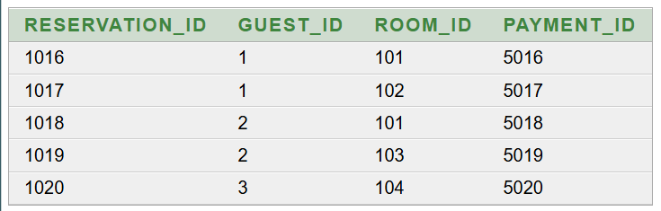
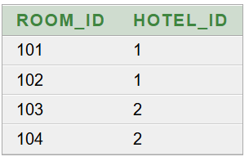
THIRD NORMAL FORM
Functional Dependencies
RESERVATION_ID → GUEST_ID, ROOM_ID, PAYMENT_ID
PAYMENT_ID → PAYMENT_AMOUNT, PAYMENT_STATUS
ROOM_ID → HOTEL_ID

Slide 55
3NF:
Earlier, the pair (ROOM_ID 101, HOTEL_ID 1) was stored twice, in reservations 1016 and 1018.
Now each room-to-hotel fact is stored only once, in ROOM.
Redundancy / Anomalies in 3NF :
Update anomaly removed: if Room 101 moves to another hotel, only one row in ROOM changes.
Insertion anomaly removed: a new room can be added to ROOM before anyone reserves it.
Deletion anomaly removed: deleting a reservation no longer deletes the room-to-hotel information.

Slide 56
Lossless Join:
RESERVATION ∩ ROOM = {ROOM_ID}, which is the primary key of ROOM.
RESERVATION ∩ PAYMENT = {PAYMENT_ID}, which is the primary key of PAYMENT.
Because the common attribute is a key in each case, the decomposition is lossless.
Joining RESERVATION with ROOM on ROOM_ID and then with PAYMENT on PAYMENT_ID reproduces the original 5 rows, with no missing or spurious tuples.
All three FDs are preserved in the separate tables, so the decomposition is also dependency-preserving.

Slide 57
CONCLUSION
To conclude, our Hotel Reservation Management System helps manage customers, rooms, reservations, and payments in an organized way. It reduces manual work, improves data management, and provides quick access to accurate information. Overall, it makes the hotel reservation process more efficient and reliable.

Slide 58
Thank you

